Slide 1
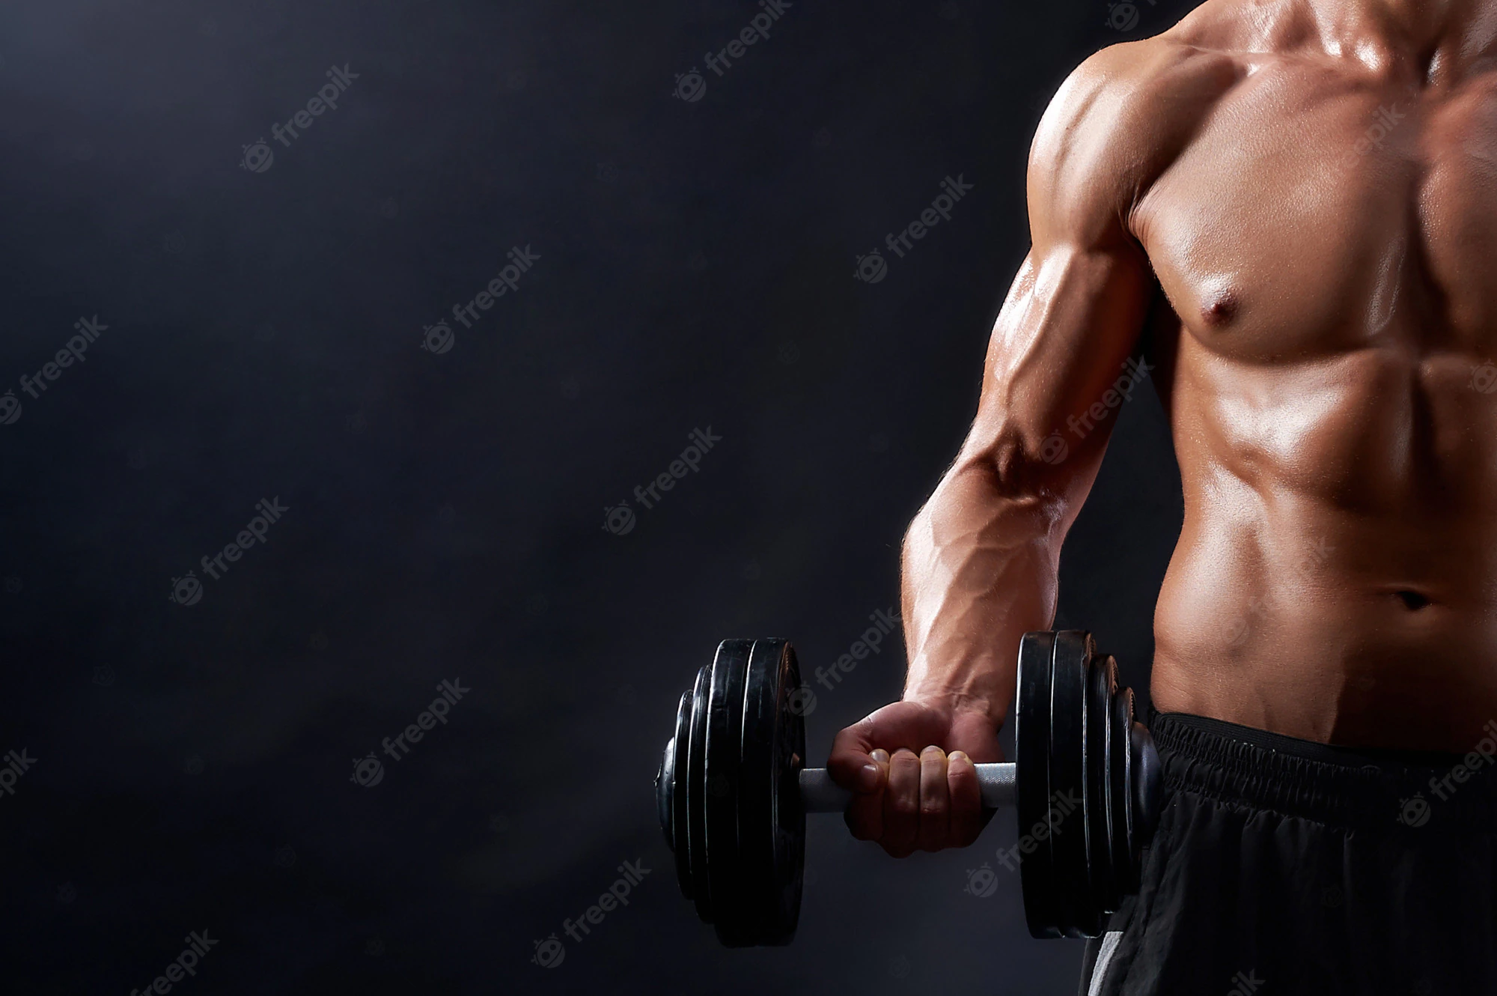
IOTTI SPA
Have you ever felt tired after the gym?

Slide 2
people who take care of their body are only interested in quality
nowadays the quality within massage parlors is going down.
who wants the best must be satisfied

Slide 3
this is why IOTTI SPA was born, a high quality spa that offers many services such as massages, sauna, Turkish bath and swimming pools, located next to a gym

Slide 4
IOTTI SPA differs from the other massage center for
QUALITY: we offers an high quality service by a qualified staff and a beautifull location
Position: we are located next to a gym in order to attract people who takes care of their body

